Slide 1
AWS Black Belt Capstone Project
Joshua Fox
December 2020

Slide 2
Goal
Identify fraudulent cases in data about mobile payments
A binary classification problem

Slide 3
TOC
Architecture
AWS Technologies (Console)
Data ingestion and transformation
Visualization
Preparation
Training
Training Model
Evaluate ML models
Improving ML model accuracy
ML Ops (Console)
Review of rubric

Slide 4
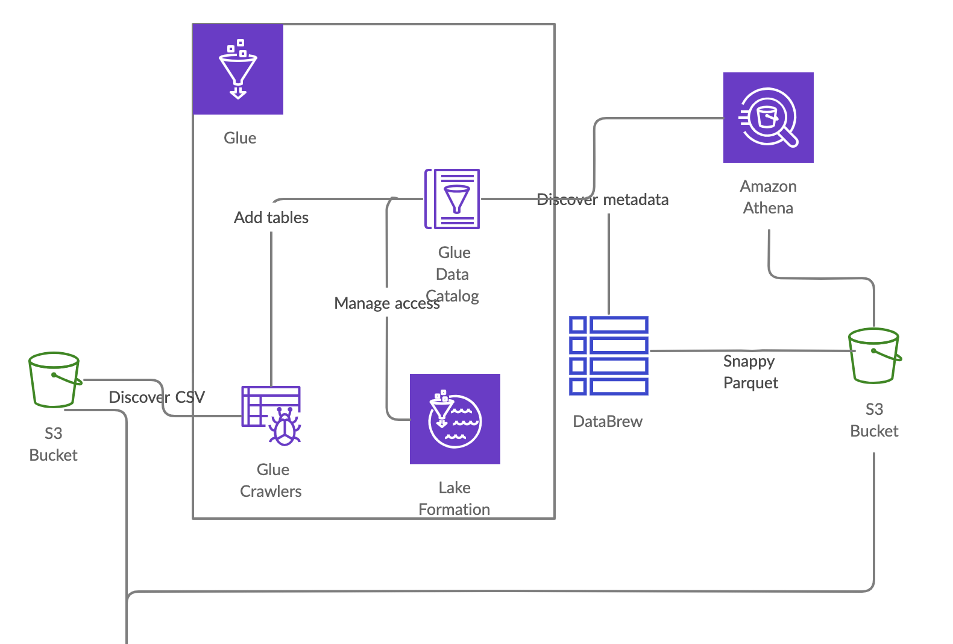
Data
preparation
S3 data used in ML, next slide

Slide 5
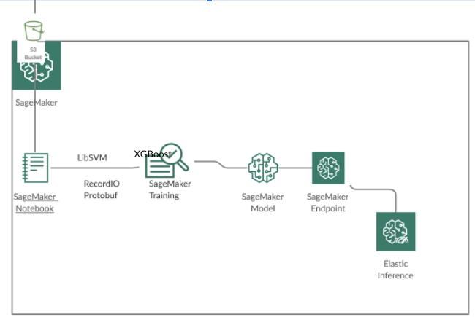
ML
S3 data used in ML, from previous slide
XGBoost
XGBoost

Slide 6
GitHub
https://github.com/doitintl/fraud-detect-blackbelt
Notebook
Databrew transformation for Athena and for training

Slide 7
Caveats
This is small dataset (~600 MB). The solution was built for a much larger dataset but so is not what we’d do in production.
There are always more possibilities for implementation. I’ll mention some in the presentation.

Slide 8
Data Ingestion and Transformation

Slide 9
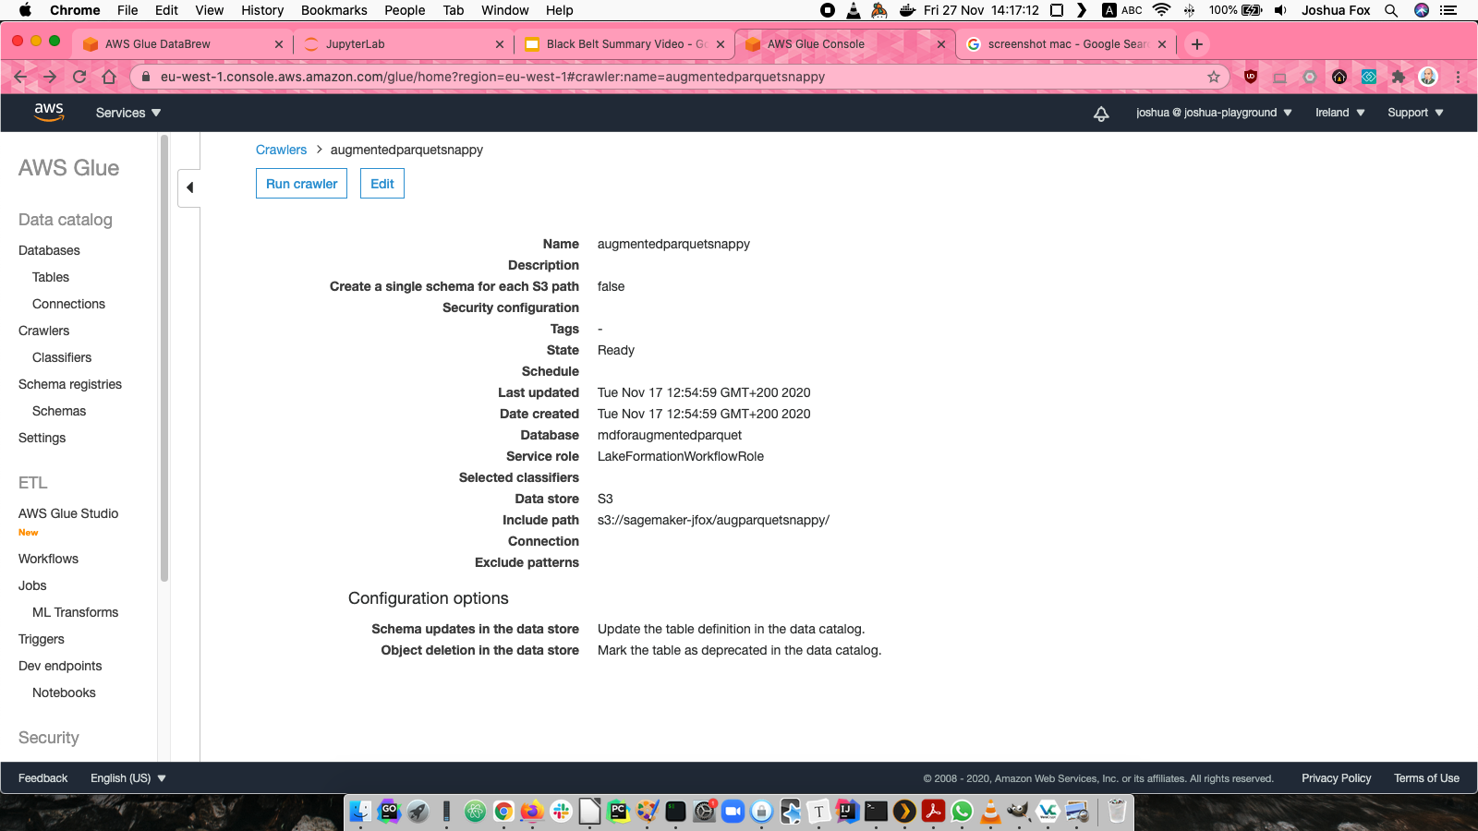
Glue Crawler

Slide 10
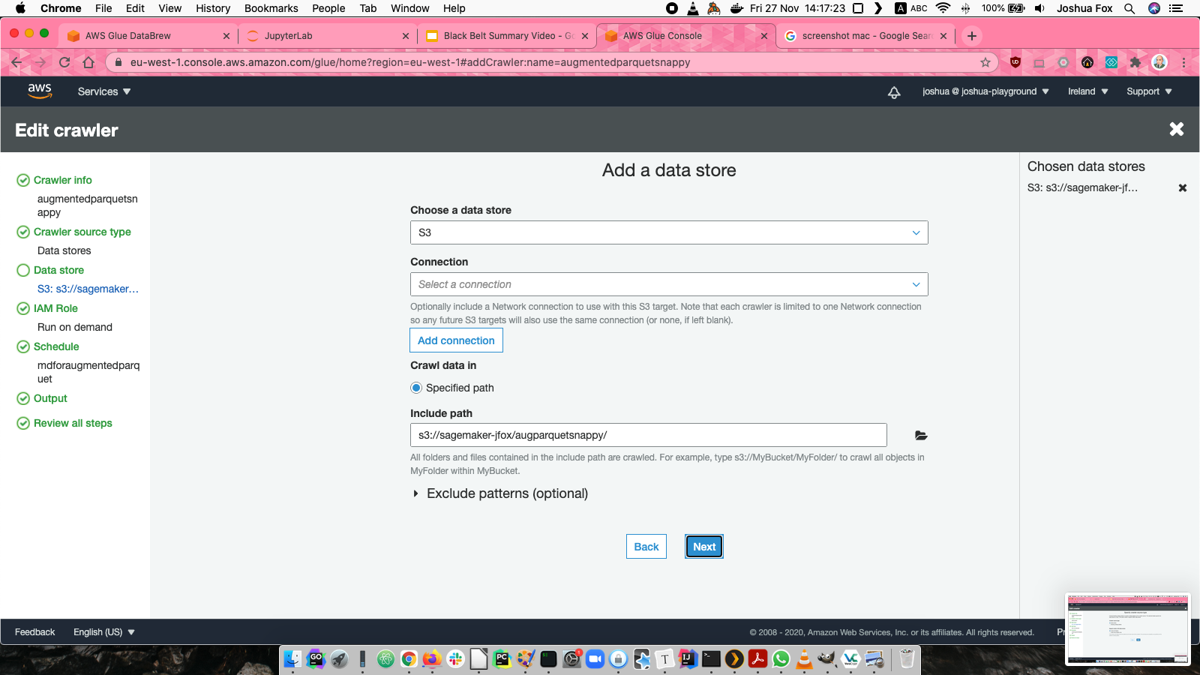
Glue Crawler

Slide 11
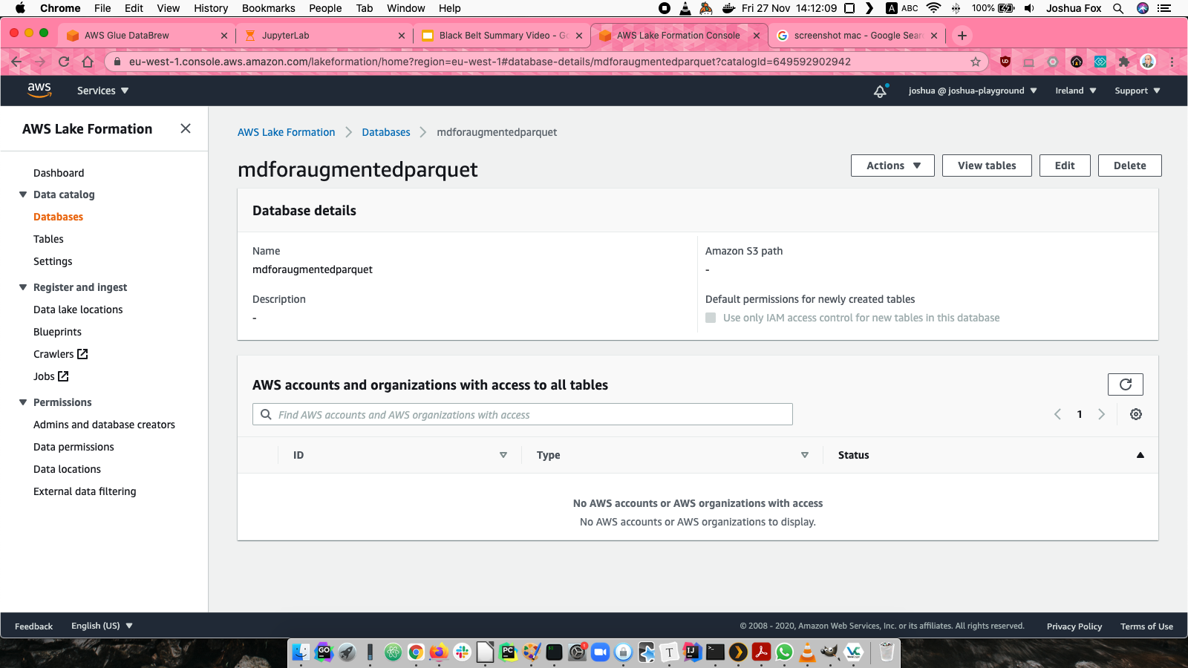
Data Catalog: Database

Slide 12
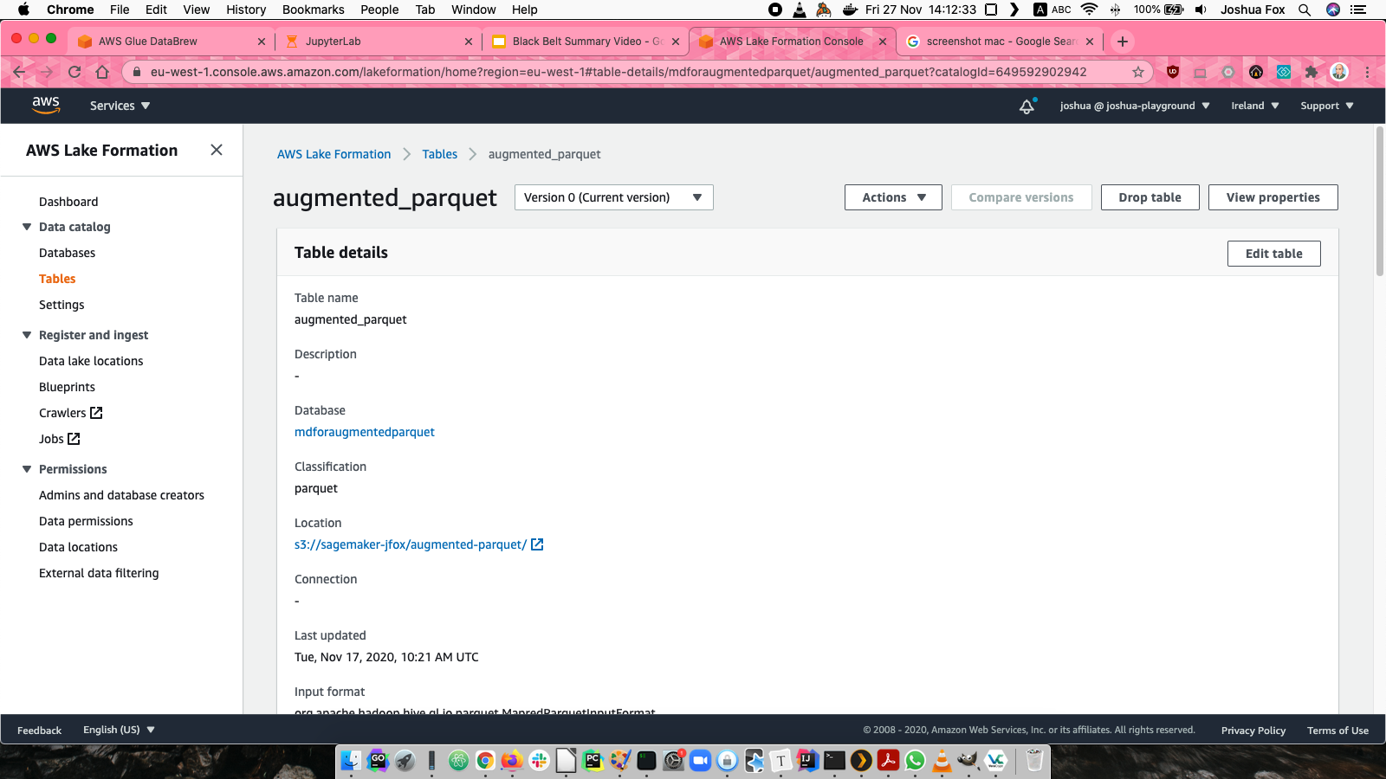
Data Catalog: Table

Slide 13
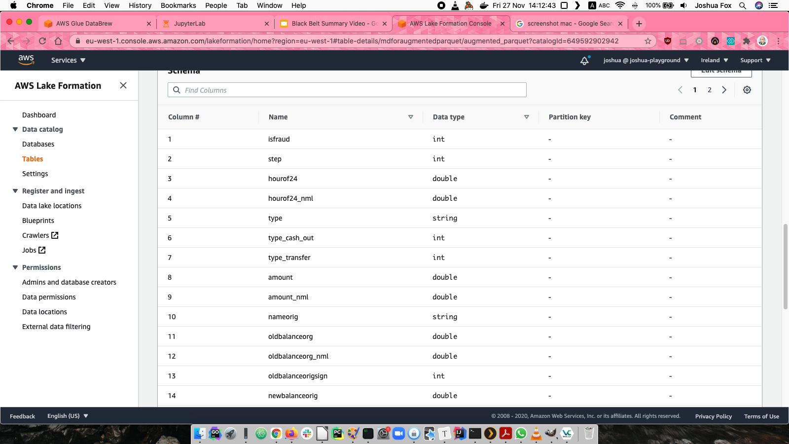
Data Catalog: Schemas

Slide 14
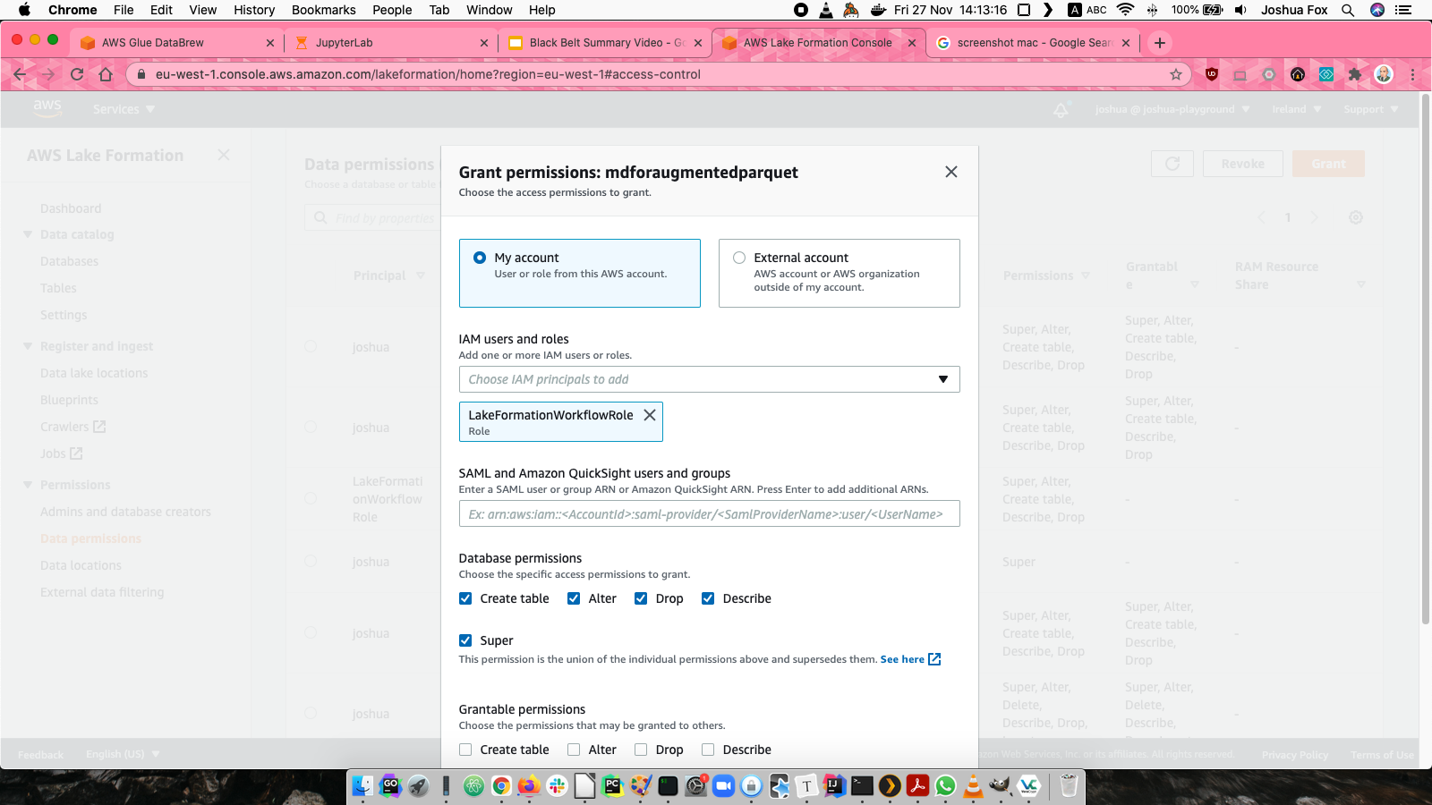
Lake Formation & Data Catalog: Permissions

Slide 15
DataBrew transformation
Two outputs
For Athena queries of rich data: Add fields
For training: Add fields, delete unneeded fields

Slide 16
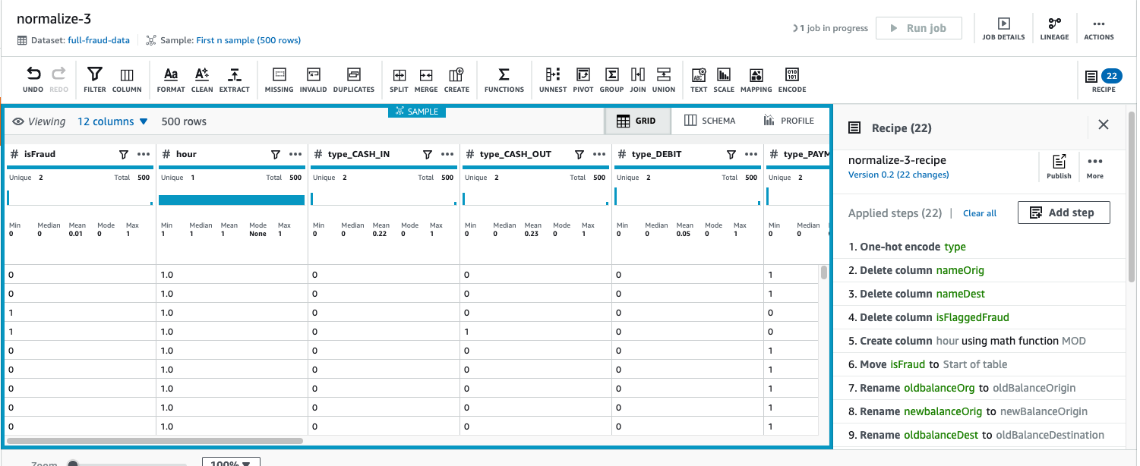
DataBrew transformation

Slide 17
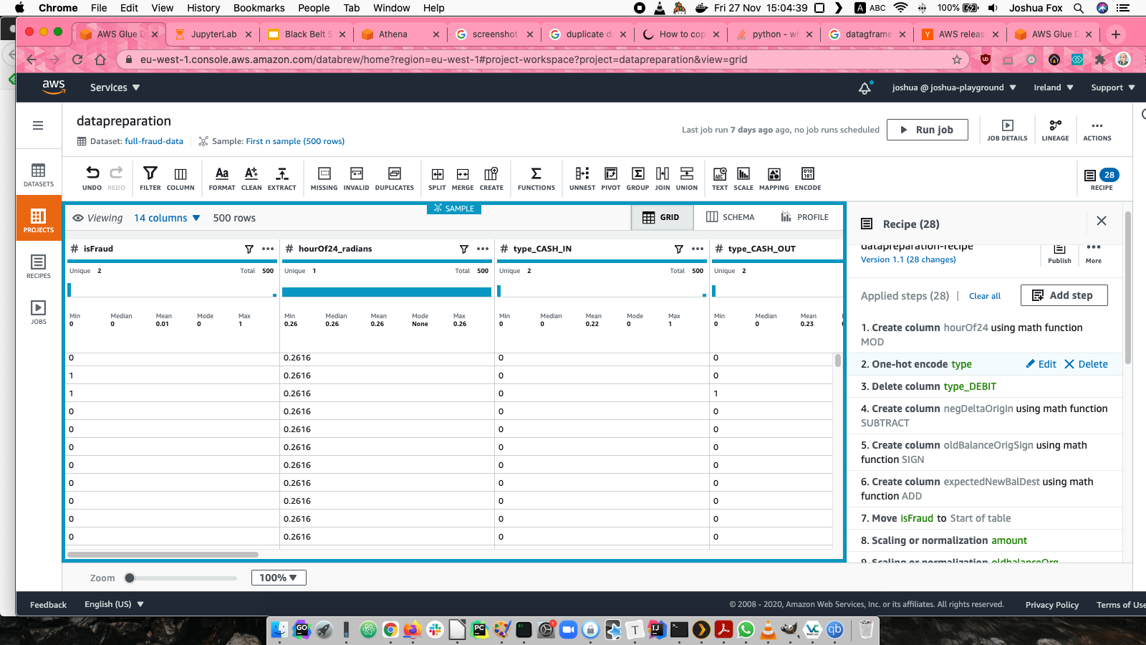
DataBrew Transformation

Slide 18
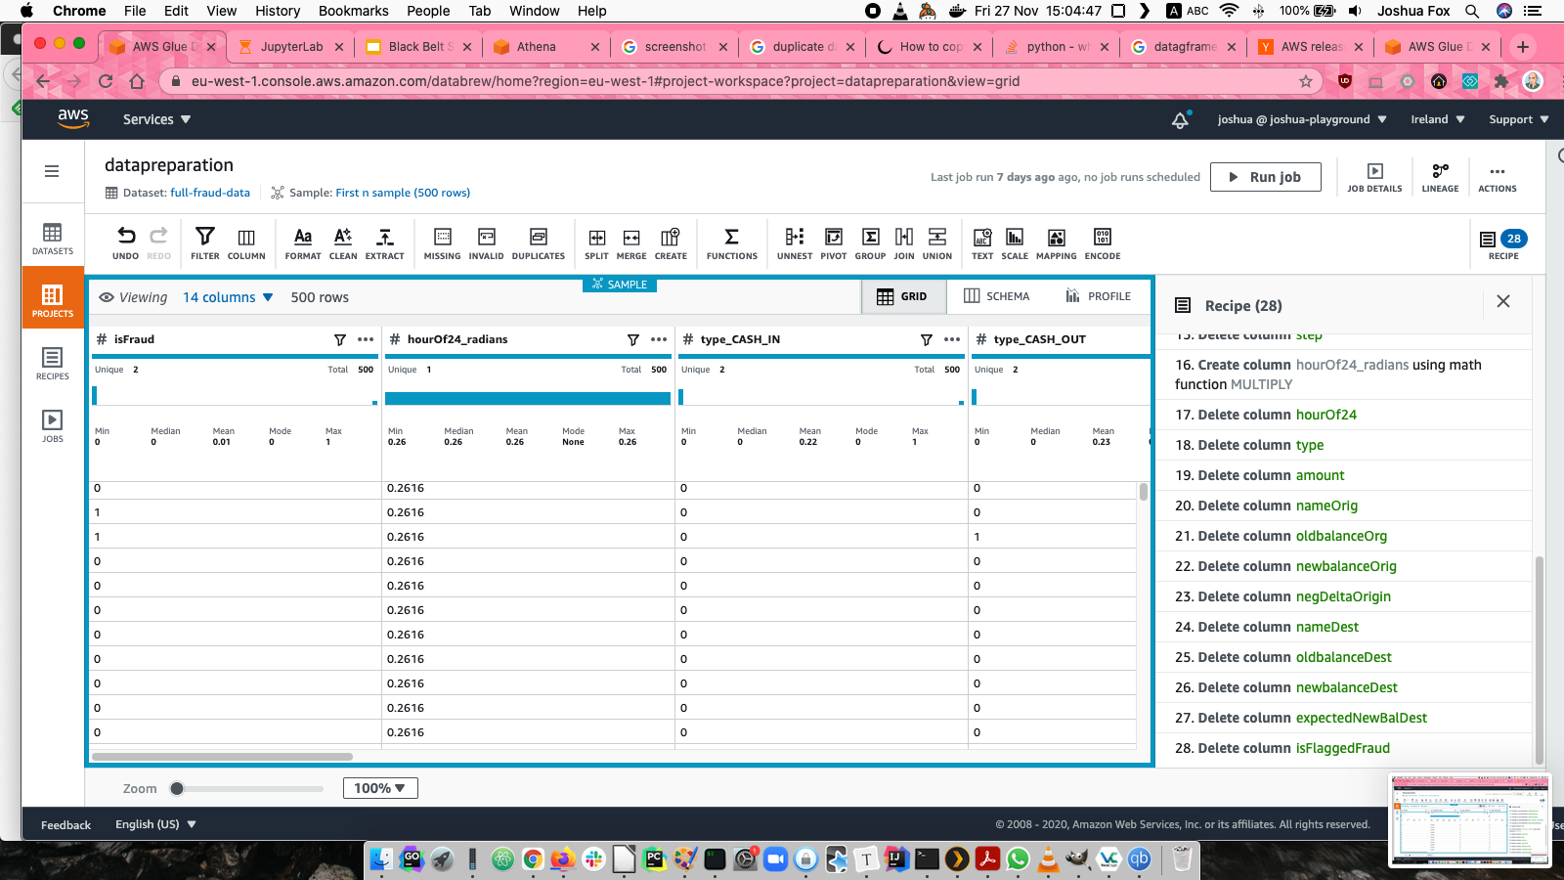
DataBrew transformation

Slide 19
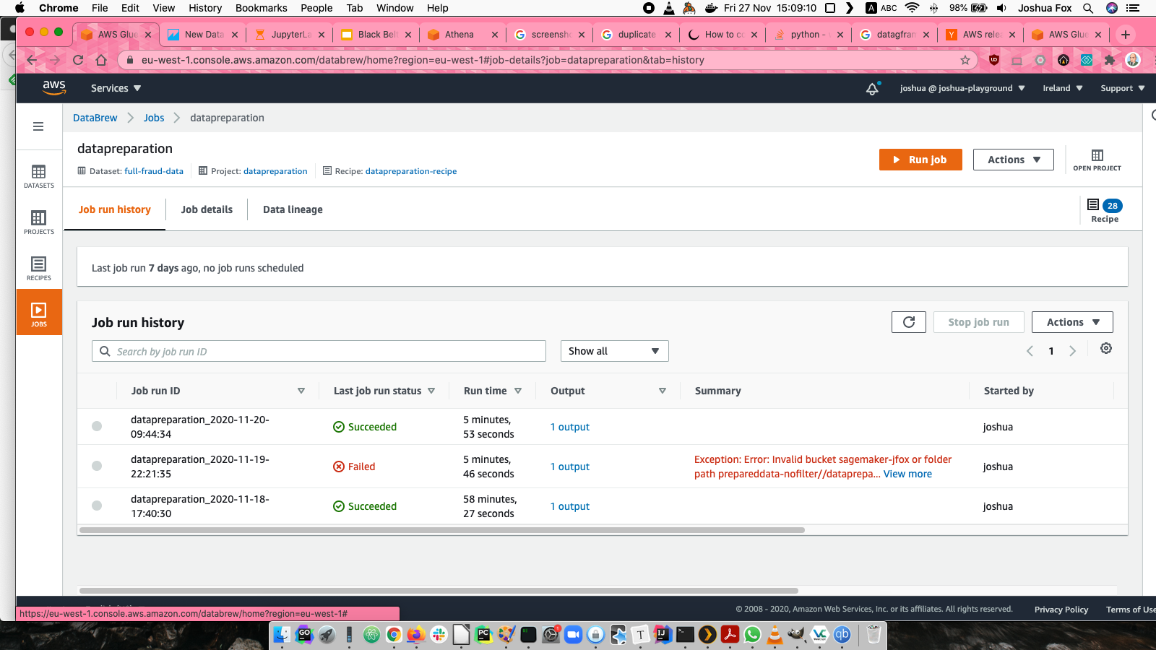
DataBrew Glue jobs

Slide 20
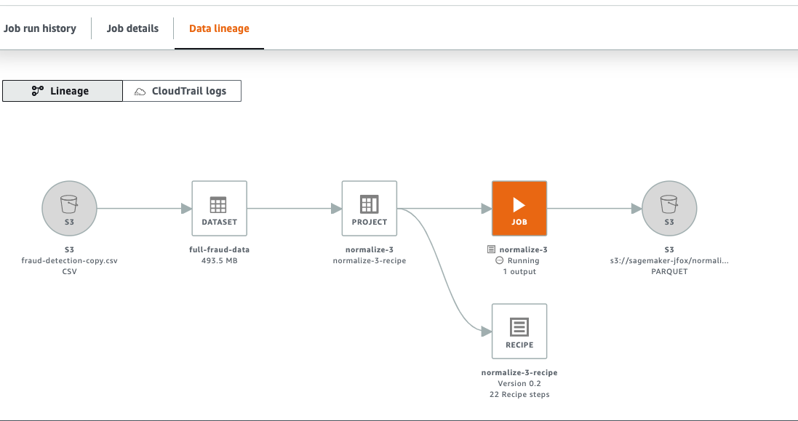
DataBrew lineage

Slide 21
Data Visualization

Slide 22
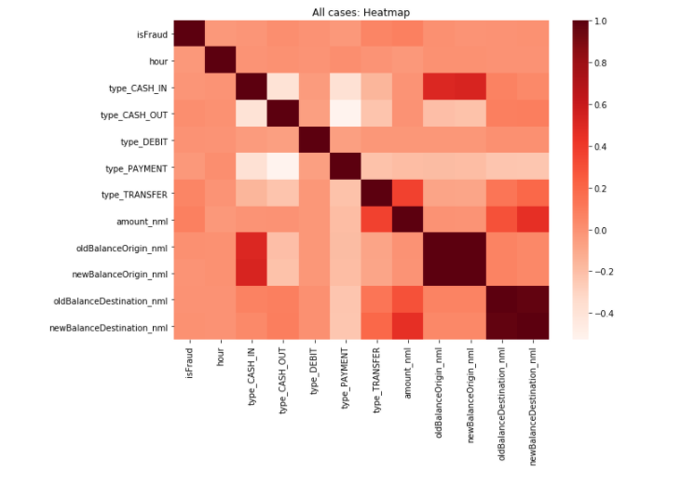
Feature correlation to identify relevant features
All rows

Slide 23
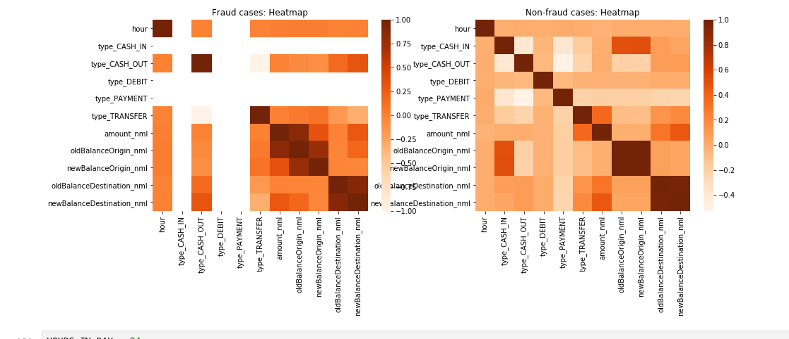
Feature correlation to identify relevant features
Fraud and non-fraud cases, separately

Slide 24
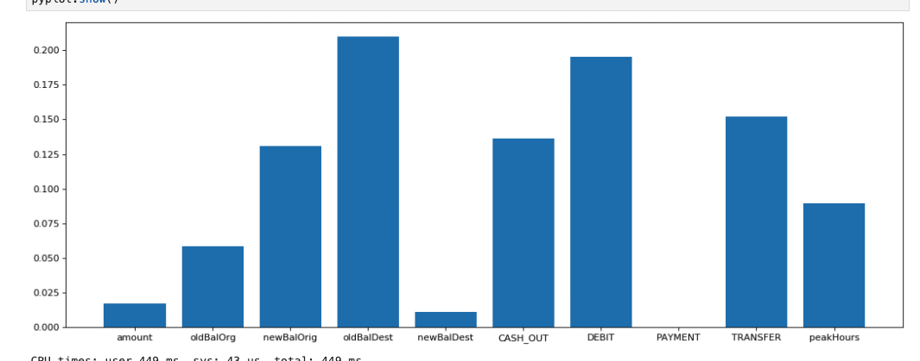
XGBoost Feature Importance to identify relevant features

Slide 25
Others (presented later)
Bar chart with log axes to visualize positive/negative distribution
Pie chart to visualize distribution of types of transactions
Line chart to visualize distribution of fraud across hours
Precision-Recall curve to visualize success in training on unbalanced set

Slide 26
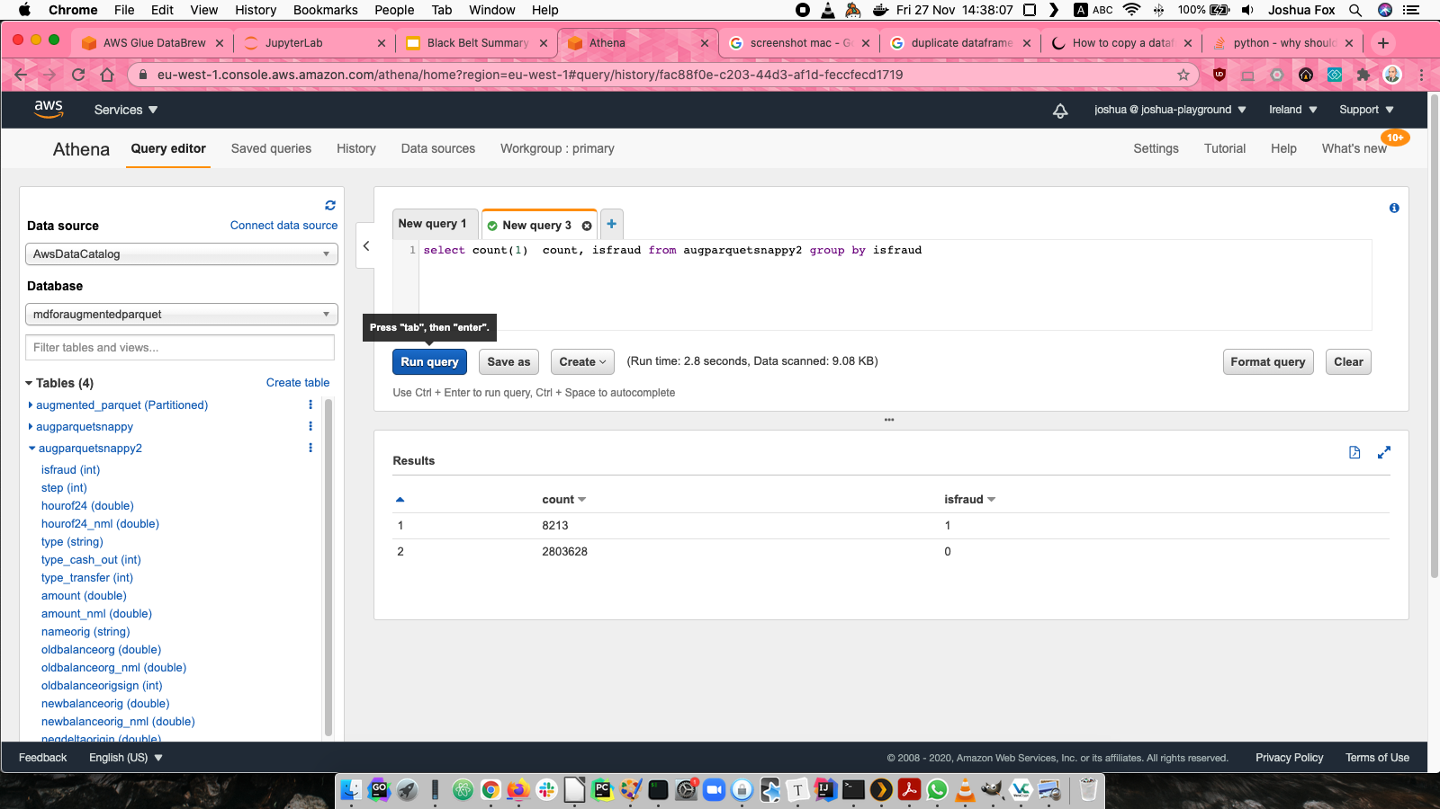
Athena
For queries into a prepared dataset in S3 registered in Glue Catalog

Slide 27
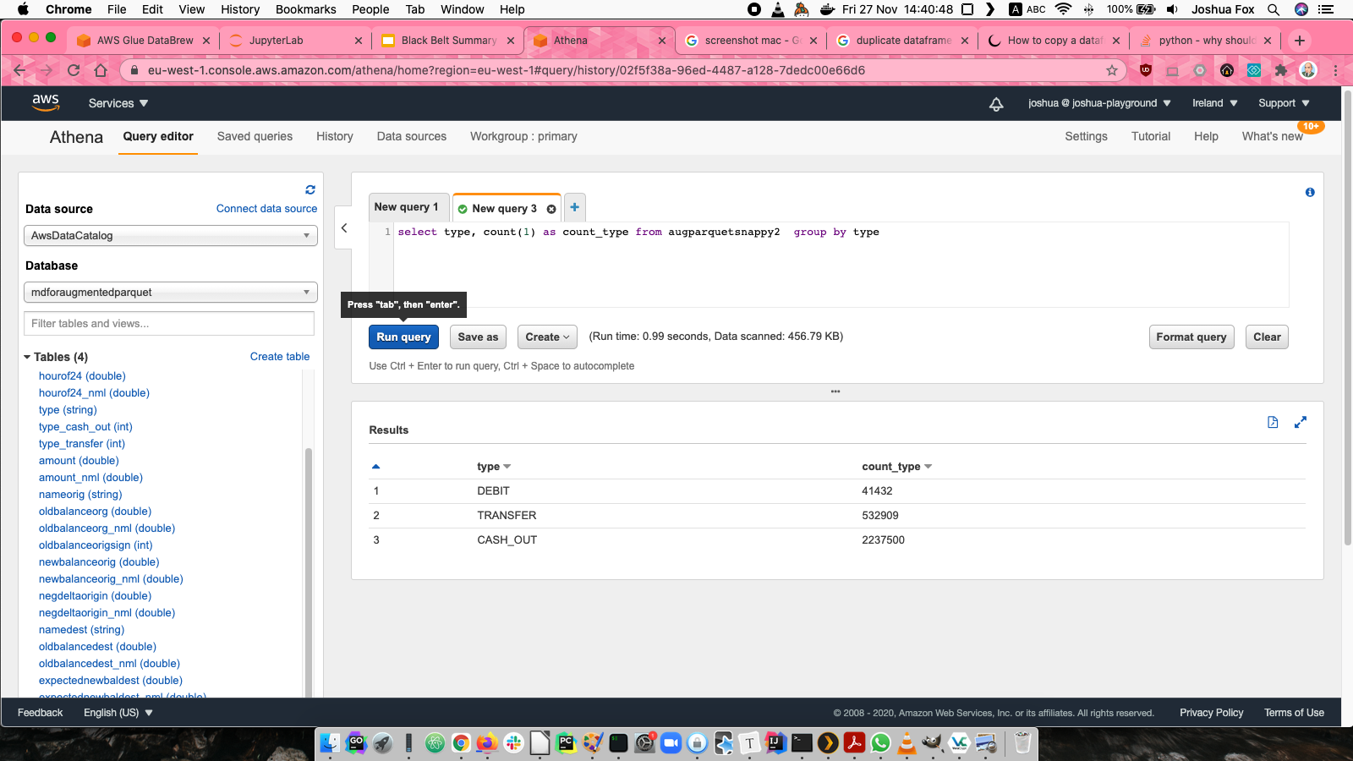
Athena

Slide 28
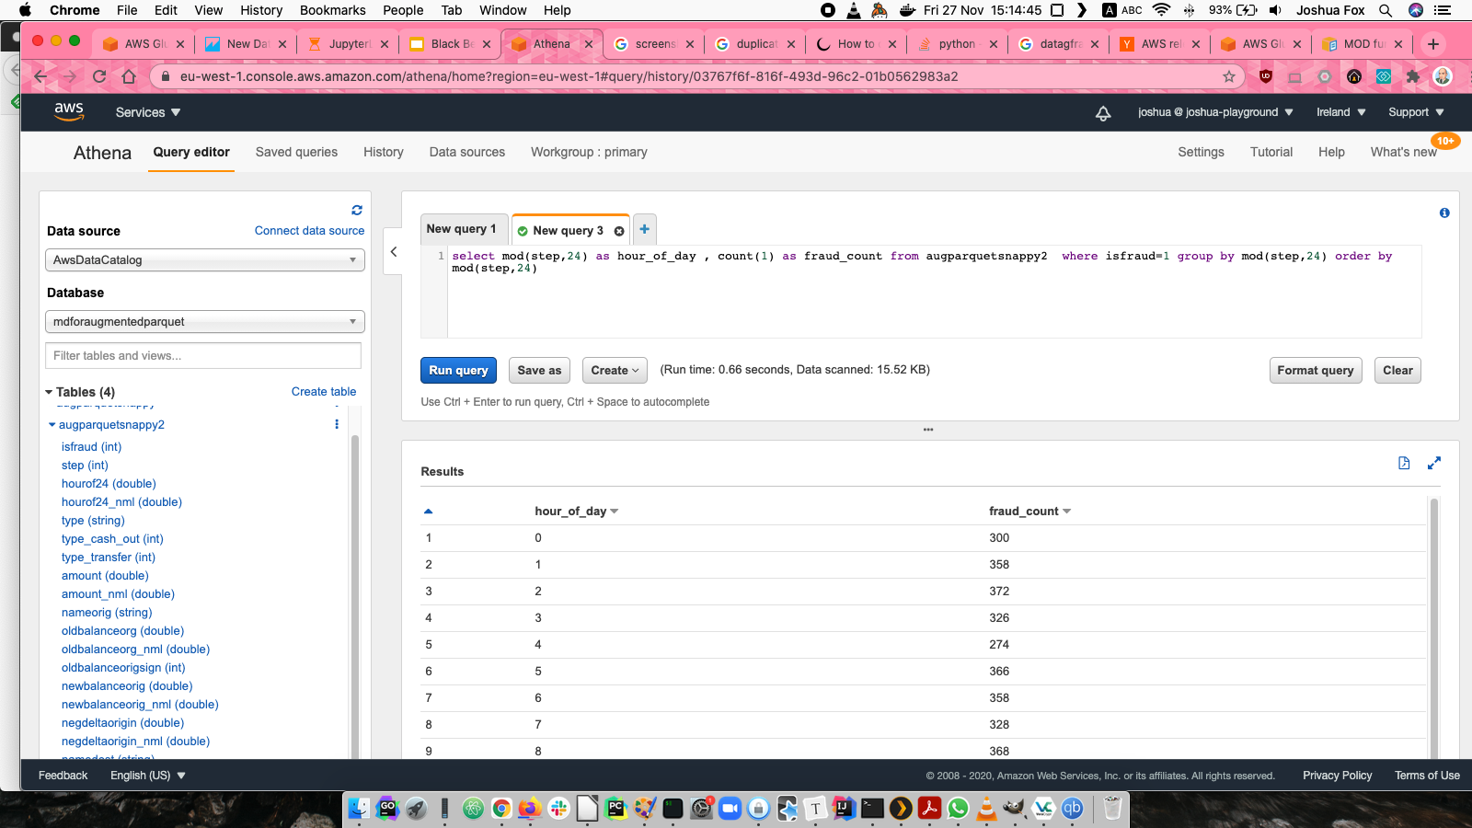
Athena

Slide 29
Data Preparation

Slide 30
Data Preparation
Identify significant features using XGBoost Feature Importance and Heatmaps

Slide 31
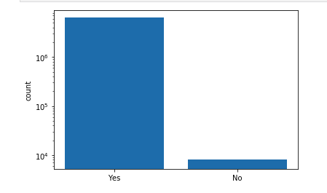
Unbalanced data: Oversampling
SMOTENC
Random selection.
Positive weighting parameter in xgboost, does the job even better.
positives/negatives
Or square root of that (which is what worked best)

Slide 32
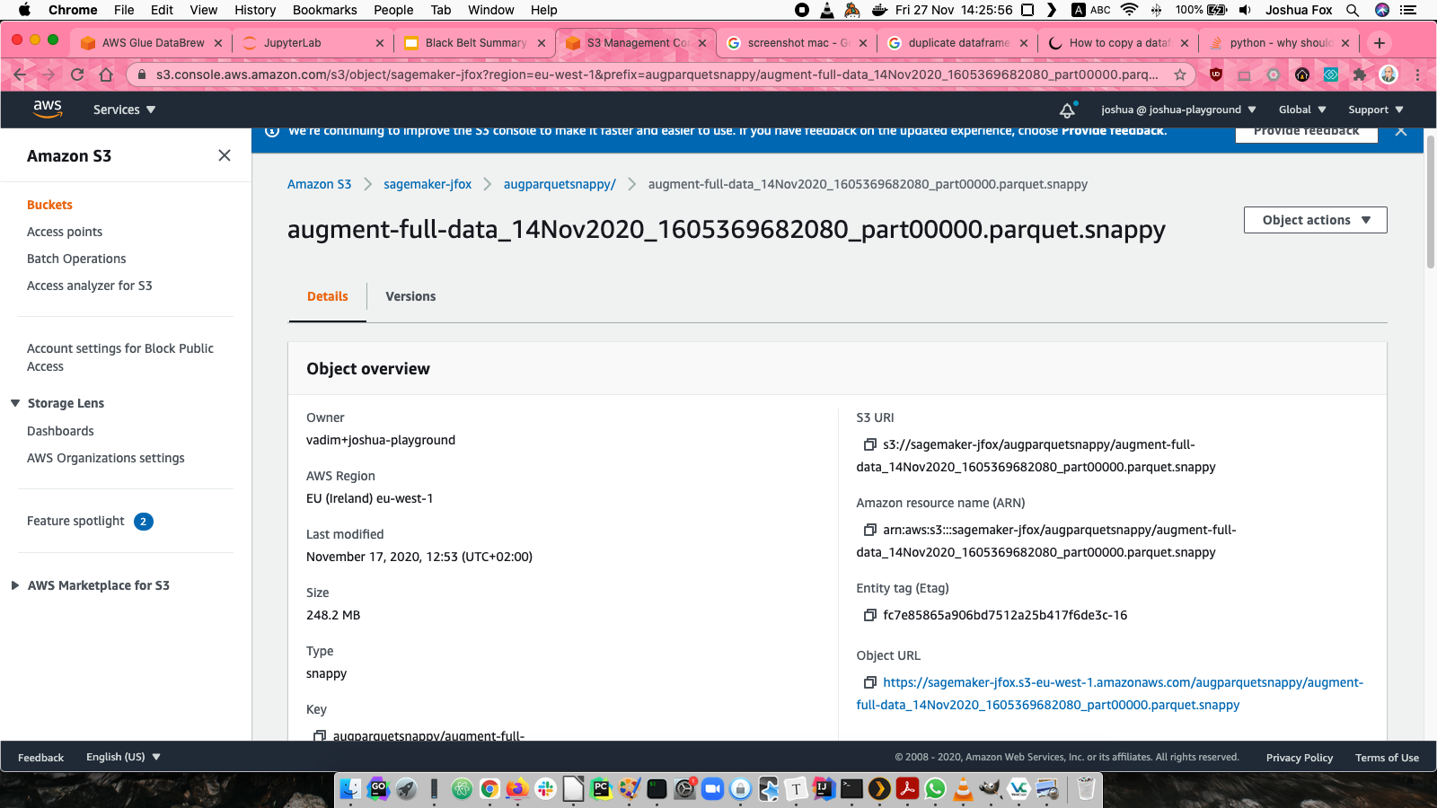
Data Format
CSV original data
Snappy Parquet for Athena queries
LibSVM for XGBoost input
RecordIO Protobuf for Linear Learner

Slide 33
Transformation
Transform data with Glue where possible
Normalize (Z-score) all numerical (non-categorical) features
Cleaning: Drop features that add nothing, as shown by EDA.
isFlaggedFraud
High-cardinality categorical features
Drop original features after derived features created

Slide 34
Training Model

Slide 35
Prepare datasets
During development, and exploratory Data Analysis, use a fraction of the 6.2M lines
Shuffle data
Split randomly into datasets
Training
Validation
Hold-out test datasets

Slide 36
Parameter tuning
Model parameter tuning, whether by manual attempts or by hypertuning (discussed later)
alpha: L1 regularization
eta :Learning rate, Step size shrinkage
epochs based on target metric (AUCPR) , for good convergence but not beyond, to prevent overfitting and save resources
min_child_weight When to give up on further partitioning
Hyperparameter Tuning (discussed later)

Slide 37
Evaluate ML Models

Slide 38
Metrics
Eval metric in this Binary classification with unbalanced classes is aucpr.
Also experiment with other metrics like auc and error@0.35

Slide 39
XGBoost vs other models for binary classifciation
Experimented with n Linear Learner: XGBoost gives better metrics and speed
Factorization Macines: The data is not the sparse, high-dimensional data suited to Factorization machines

Slide 40
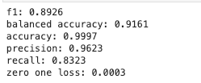
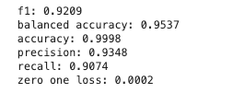
Metrics
eval_metric aucpr: 0.99 reached (but beware overfitting)
Validation metrics, with the most important metrics for this unbalanced dataset first.
fit() Hypertuning

Slide 41
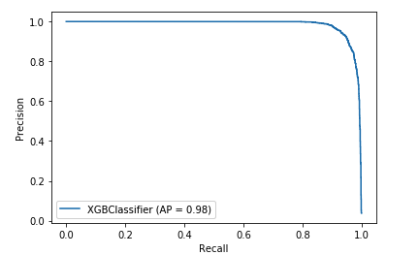
Precision-Recall curve

Slide 42
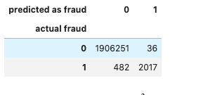
Confusion Matrix

Slide 43
Improving ML models accuracy

Slide 44
Hyperparameter tuning
With Bayesian and Random search
Explore space of eta, min_child_weight, alpha, max_depth
Parallel processing, particularly with Random search
Choose max number of jobs for thorough search yet restricting time and cost

Slide 45
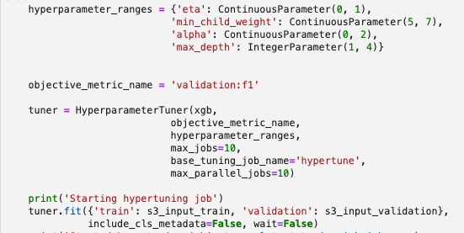
Hyperparameter tuning

Slide 46
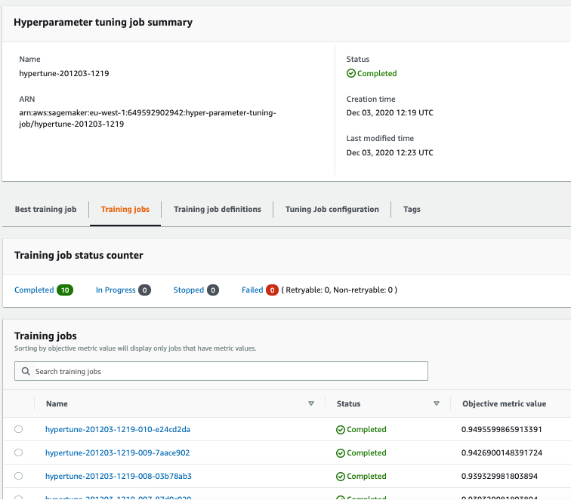
Hyperparameter tuning

Slide 47
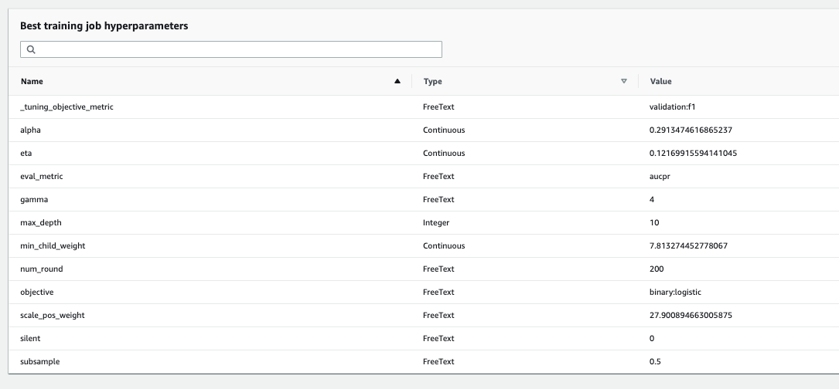
Hyperparameter tuning

Slide 48
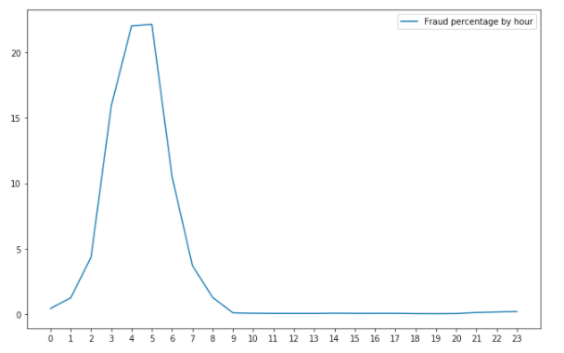
Hours as 24 hour cycle
Adding new domain-specific features

Slide 49
Categorical features
One-hot the type feature
Heatmap shows that all Fraud is in TRANSFER and CASH_OUT types. Other types can be removed; or let the model automatically give them zero weight.
Dummy encoding (“drop one”) tried but not needed.
For high-cardinality features like “names” of senders and recipients
Tried HashingEncoder
Dropping these features gives best results

Slide 50
ML Implementation/Operations

Slide 51
Secure data with roles in LakeFormation

Slide 52
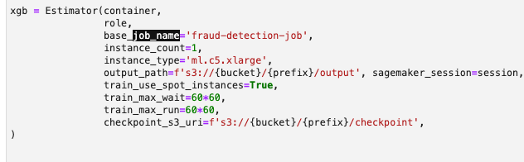
Train with Spot Instances

Slide 53
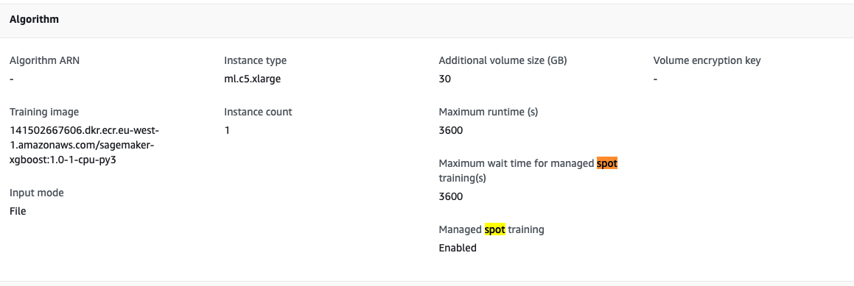
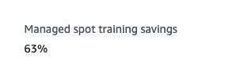
Train with Spot Instances

Slide 54
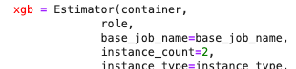
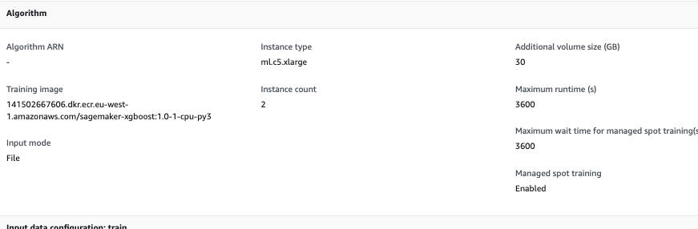
Train with Multiple Instances

Slide 55
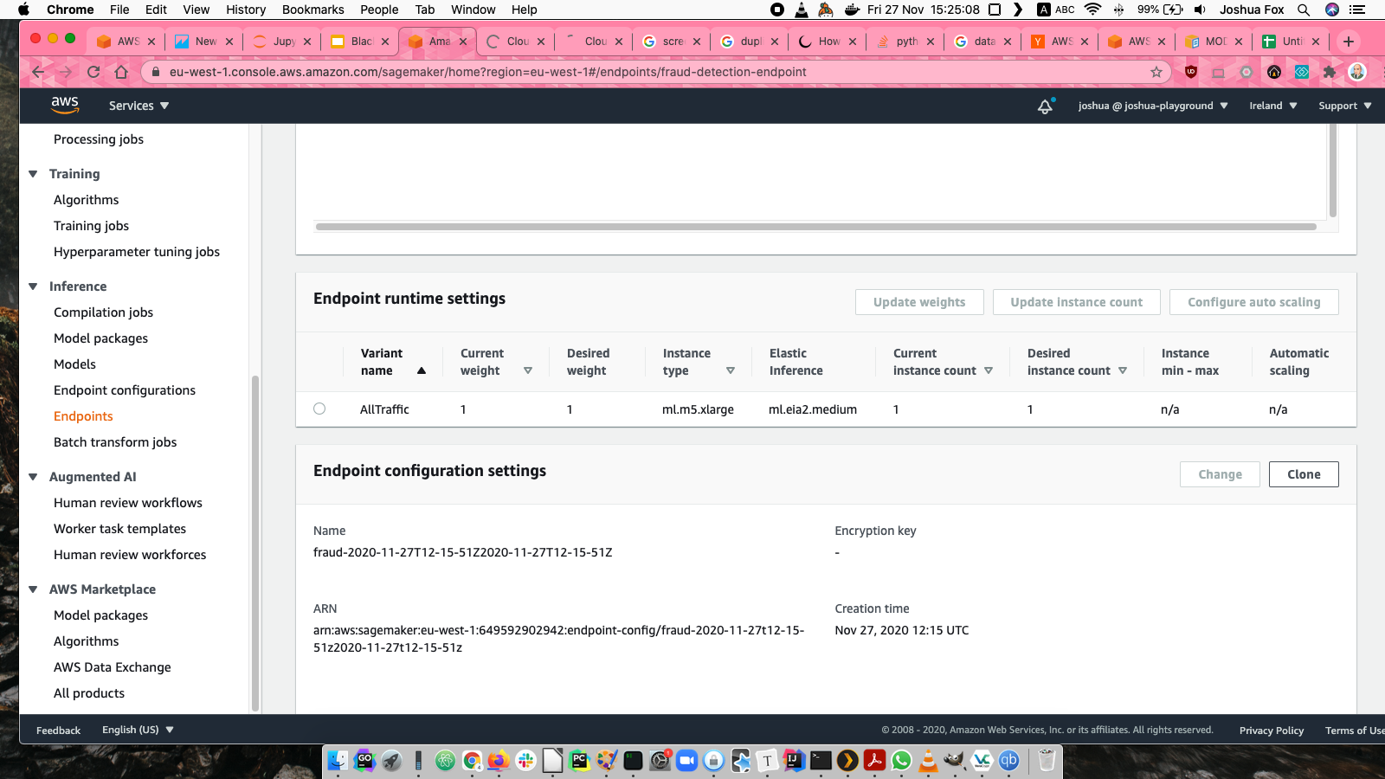
Endpoint with Elastic Inference

Slide 56
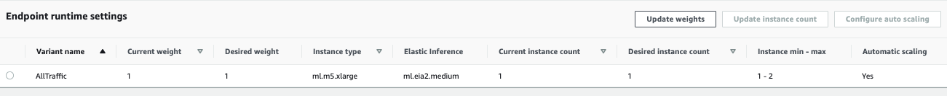
Scalable Endpoint
Before scaling
Scaled after high prediction traffic

Slide 57
See Report on Rubric achievement

